Slide 1
Dynamic Authenticated Index Structures for Outsourced Databases
Feifei Li, Marios Hadjieleftheriou, George Kollios, Leonid Reyzin
Boston University
AT&T Labs-Research
Notes:
H. Hacigumus, B. R. Iyer, and S. Mehrotra, ICDE02

Slide 2
Outsourced Database (ODB) Systems [HIM02]
Owner(s): publish database
Servers: host database and provide query services
Clients: query the owner’s database through servers
Clients
Owner
Servers
Security Issues: untrusted or compromised servers
H. Hacigumus, B. R. Iyer, and S. Mehrotra, ICDE02
Notes:
H. Hacigumus, B. R. Iyer, and S. Mehrotra, ICDE02

Slide 3
Query Example
Select * from T where 5<A<11
Client
Owner
Return 6,9
 | A | B
r₁ | …
… | …
r_{i-1} | 5
r_{i} | 6
r_{i+1} | 9
r_{i+2} | 12
 | A | B
r₁ | …
… | …
r_{i-1} | 5
r_{i} | 6
r_{i+1} | 9
r_{i+2} | 12
Server
Notes:
H. Hacigumus, B. R. Iyer, and S. Mehrotra, ICDE02

Slide 4
Injection
Select * from T where 5<A<11
Client
Owner
Returns 6, 7, 9
 | A | B
r₁ | …
… | …
r_{i-1} | 5
r_{i} | 6
r_{i+1} | 9
r_{i+2} | 12
 | A | B
r₁ | …
… | …
r_{i-1} | 5
r_{i} | 6
r_{i+1} | 9
r_{i+2} | 12
Server
Notes:
H. Hacigumus, B. R. Iyer, and S. Mehrotra, ICDE02

Slide 5
Drop
Select * from T where 5<A<11
Client
Owner
Returns 6
 | A | B
r₁ | …
… | …
r_{i-1} | 5
r_{i} | 6
r_{i+1} | 9
r_{i+2} | 12
 | A | B
r₁ | …
… | …
r_{i-1} | 5
r_{i} | 6
r_{i+1} | 9
r_{i+2} | 12
Server
Notes:
H. Hacigumus, B. R. Iyer, and S. Mehrotra, ICDE02

Slide 6
Omission
Select * from T where 5<A<11
Client
Owner
Returns 6,9
 | A | B
r₁ | …
… | …
r_{i-1} | 5
r_{i} | 6
r_{i+1} | 8
r_{i+2} | 9
r_{i+3} | 12
 | A | B
r₁ | …
… | …
r_{i-1} | 5
r_{i} | 6
r_{i+1} | 9
r_{i+2} | 12
Update
Server
Notes:
H. Hacigumus, B. R. Iyer, and S. Mehrotra, ICDE02

Slide 7
Query Authentication
Query Correctness
results do exist in the owner's database
Query Completeness
no answers have been omitted from the result
Query Freshness
results are based on the most current version of the database
Notes:
H. Hacigumus, B. R. Iyer, and S. Mehrotra, ICDE02

Slide 8
General Approach for Query Authentication in ODB Systems
Query Q
VO: verifiable object
Client
Returns both result for Q and associated VO
Owner
 | A | B
r₁ | …
… | …
r_{i-1} | 5
r_{i} | 6
r_{i+2} | 9
r_{i+3} | 12
Authenticated Data
Structures
Server
Notes:
H. Hacigumus, B. R. Iyer, and S. Mehrotra, ICDE02

Slide 9
Cost Metrics
The computation overhead for the owner
The owner-server communication cost
The storage overhead for the server
The computation overhead for the server
The client-server communication cost
The computation cost for the client (for verification)
The update cost
Notes:
H. Hacigumus, B. R. Iyer, and S. Mehrotra, ICDE02

Slide 10
Outline
Problem overview
Cryptographic tools
Merkle B (MB) Tree
Embedded Merkle B (EMB) Tree
Related Works
Experiments
Notes:
H. Hacigumus, B. R. Iyer, and S. Mehrotra, ICDE02

Slide 11
Collision-resistant hash functions
It is computational hard to find x₁ and x₂ s.t. h(x₁)=h(x₂)
Computational hard? Based on well established assumptions such as discrete logarithms [M90]
SHA1 [SHA195]
Observations:
  Computation cost: 3-6 μs
  Storage cost: 20 bytes
  Under Crypto++ [crypto] and OpenSSL [openssl]
K. McCurley, American Mathematical Society, 1990.
Notes:
H. Hacigumus, B. R. Iyer, and S. Mehrotra, ICDE02

Slide 12
Public key digital signature schemes
Sender
m
Insecure Channel
Recipient
KeyGen →(SK, PK)
σ
SK
m
σ
Ver(m, PK, σ) → valid?
Sign(m, SK) → σ
Notes:
H. Hacigumus, B. R. Iyer, and S. Mehrotra, ICDE02

Slide 13
Public key digital signature schemes
Formally defined by [GMR88]
One such scheme: RSA [RSA78]
Observations
  Computation cost: about 3-4 ms for signing and 200-300 us for verifying
  Storage cost: 128 bytes
  Under Crypto++ [crypto] and OpenSSL [openssl]
S. Goldwasser S. Micali R. Rivest SIAM Journal on Computing 1988. R. Rivest A. Shamir L. Adleman, Commun. ACM 1978
Notes:
H. Hacigumus, B. R. Iyer, and S. Mehrotra, ICDE02

Slide 14
Merkle Hash Tree [M89]
Sign(h_{1..8},SK)
σ
h_{1..8}
h_{1..4}
h_{5..8}
h₁₂=
H(h₁|h₂)
h₁₂
h₃₄
h₅₆
h₇₈
h₁
h₂
h₃
h₄
h₅
h₆
h₇
h₈
r₁
r₂
r₃
r₄
r₅
r₆
r₇
r₈
R. C. Merkle. CRYPTO, 1989
Notes:
H. Hacigumus, B. R. Iyer, and S. Mehrotra, ICDE02

Slide 15
Outline
Problem overview
Cryptographic tools
Merkle B (MB) Tree
Embedded Merkle B (EMB) Tree
Related Works
Experiments
Notes:
H. Hacigumus, B. R. Iyer, and S. Mehrotra, ICDE02

Slide 16
Merkle B(MB) Tree
p₀
h₀
p₁
k₁
h₁
…
p_{f}
k_{f}
h_{f}
h₁=Hash(h₁₀|…|h_{1f})
p₁₀
h₁₀
p₁₁
k₁₁
h₁₁
For root node, σ=Sign(h₀|…|h_{f})
Given page size P, fanout of B+ tree f is:
f=(P-|int|-|h|)/(2|int|+|h|)
Notes:
H. Hacigumus, B. R. Iyer, and S. Mehrotra, ICDE02
扇出，就是一个节点能够指向多少个子节点

Slide 17
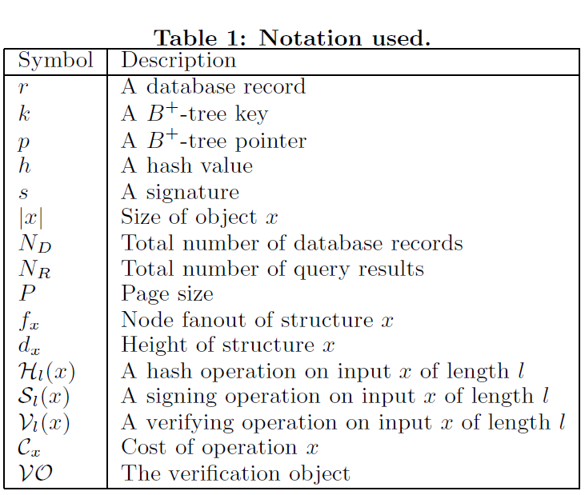

Slide 18
Range Selection Query in MB tree
Path LCA(q)
Path: its hash path in Merkle B tree
LCA(q)
Query subtree
LB(q)
RB(q)
Query range q
Notes:
H. Hacigumus, B. R. Iyer, and S. Mehrotra, ICDE02

Slide 19
Query path
return h_{i}
…
I₁
I₂
I₃
I₄
I₅
I₆
I₇
I₈
…
L₁
L₂
L₃
L₄
L₅
L₆
L₇
L₈
L₉
L₁₀
L₁₁
L₁₂
Query q
return h_{i}
LB(q)
return r_{i}
Notes:
H. Hacigumus, B. R. Iyer, and S. Mehrotra, ICDE02
Leaf node

Slide 20
Query Example: f=2
Select * from T where 5<A<11
Sign(h_{1..8},SK)
σ
h_{1..8}
LCA(q)
h_{1..4}
h_{1..4}
h_{5..8}
Path LCA(q)
h₁₂
h₃₄
h₅₆
h₇₈
h₁
h₂
h₃
h₄
h₅
h₆
h₇
h₈
1
2
3
4
5
6
9
12
VO: 5, 12, h_{1..4}, σ
LB(q)
q
RB(q)
Notes:
H. Hacigumus, B. R. Iyer, and S. Mehrotra, ICDE02

Slide 21
Client Side Verification
Select * from T where 5<A<11
Ver(h_{1..8},PK, σ)
Valid?
VO: 5, 12, h_{1..4}, σ
Query results: 6, 9
h_{1..8}
h_{1..4}
h_{5..8}
h₅₆
h₇₈
Unknown to the client
h₅
h₆
h₇
h₈
5
6
9
12
Reconstruct query subtree
q
Notes:
H. Hacigumus, B. R. Iyer, and S. Mehrotra, ICDE02

Slide 22
Query Example: f=5
VO:
tuple 5,
10,
hash of 1, 3, 12, 14, 16,
hash of entry 20, 29, 42
8 hashes
10
20
20
29
29
42
42
LB(q)
1
1
3
3
5
5
6
9
10
10
12
12
14
14
16
16
q
RB(q)
20
22
23
25
…
…
…
…
Notes:
H. Hacigumus, B. R. Iyer, and S. Mehrotra, ICDE02

Slide 23
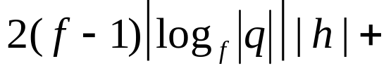
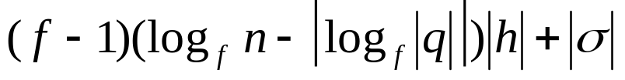
VO size of MB tree
Hash values for sibling entries for nodes along the two boundary paths of query subtree
Hash values for sibling entries for nodes along the path LCA(q).
Notes:
H. Hacigumus, B. R. Iyer, and S. Mehrotra, ICDE02

Slide 24
Outline
Problem overview
Cryptographic tools
Merkle B (MB) Tree
Embedded Merkle B (EMB) Tree
Related Works
Experiments
Notes:
H. Hacigumus, B. R. Iyer, and S. Mehrotra, ICDE02

Slide 25
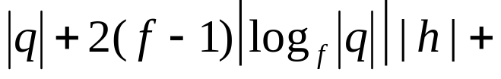
Improve c/s comm. cost
We can show that
is minimized when 2<f<3.
so f=2 is optimal in practice.
However, the query efficiency is the worst.
Notes:
H. Hacigumus, B. R. Iyer, and S. Mehrotra, ICDE02
为了使得 client 和 sever端的传输数据最小。即VO的size最小。

Slide 26
Embedded Merkle B (EMB) tree: A fractal structure
p₀
h₀
p₁
k₁
h₁
…
p_{f}
k_{f}
h_{f}
p₁₀
h₁₀
p₁₁
k₁₁
h₁₁
…
p_{1f}
k_{1f}
h_{1f}
A MB tree with fanout f_{e} built on this node
Notes:
H. Hacigumus, B. R. Iyer, and S. Mehrotra, ICDE02
这里指针指向数据节点。而hash是MB tree的root。

Slide 27
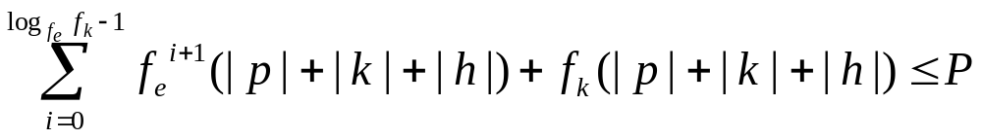
Query and Authentication
MB tree with fanout f_{K}
Each node is built with a MB tree with fanout f_{e}
Notes:
H. Hacigumus, B. R. Iyer, and S. Mehrotra, ICDE02

Slide 28

EMB tree Analysis
We can show that:
  Query cost is as a MB tree with fanout f_{k}
  Authentication cost (c/s comm. cost and client verification cost) is as a MB tree with fanout f_{e}, intuition:
  f_{k} is smaller than a normal MB tree given a page size P
Notes:
H. Hacigumus, B. R. Iyer, and S. Mehrotra, ICDE02

Slide 29
Query Example: f=5
VO:
tuple 5,
10,
hash of red circle node,
hash of red circle nodes(2),
hash of red circle nodes(2),
5 hashes
10
20
29
42
10
12
14
16
10
20
29
42
LB(q)
1
3
5
6
9
1
3
5
5
6
9
10
10
12
14
16
q
RB(q)
20
22
23
25
…
…
…
…
Notes:
H. Hacigumus, B. R. Iyer, and S. Mehrotra, ICDE02

Slide 30
EMB tree’s variants
Don’t store the embedded tree, build it on the fly – EMB⁻ tree
  Fanout f_{k} is as a normal MB tree, better query performance, better storage performance
Use multi-way search tree instead of B⁺ tree as embedded tree – EMB* tree
  Hash path in the embedded tree could stop in index level, not necessary to go to the leaf level, hence reduce the VO size
Notes:
H. Hacigumus, B. R. Iyer, and S. Mehrotra, ICDE02

Slide 31
Signature-Based Approach: ASB Tree based on [PJR05]
B+ Tree
S(r₁|r₂)
S(r₂|r₃)
…
…
S(_{n-2}|r_{n-1})
S(r_{n-1}|r_{n})
order database tuples w.r.t query attribute
sign consecutive pairs
build B+ tree on top of it
return tuples [a-1, b+1] together with signatures in [a-1, b]. (query is [a, b]) (a, b here are index)
verify any two consecutive pairs
H. Pang, A. Jain, K. Ramamritham, and K.-L. Tan.SIGMOD, 2005.
Notes:
H. Hacigumus, B. R. Iyer, and S. Mehrotra, ICDE02

Slide 32
Reduce S/C comm. Cost [MNT04]
Aggregation Signature:
m₁
m_{k}
m₁
m_{k}
σ₁
σ_{k}
σ
σ=combine(σ₁,…, σ_{k})
Overhead: computation cost of modular
multiplication with big modular base number (approx. 100 us per multiplication)
E. Mykletun, M. Narasimha, and G. Tsudik. NDSS'04
Notes:
H. Hacigumus, B. R. Iyer, and S. Mehrotra, ICDE02

Slide 33
Extend Merkle Tree for DAG Model [DGMS03] [MNDGKS04]
DAG: Directed Acyclic Graph
Apply the same idea used in merkle tree to a DAG structure
They have briefly mentioned the possibility of using B tree to improve the query efficiency: MB tree is a generalization of this idea
C. Martel, G. Nuckolls, P. Devanbu, M. Gertz, A. Kwong, and S. Stubblebine. Algorithmica 2004.
Notes:
H. Hacigumus, B. R. Iyer, and S. Mehrotra, ICDE02

Slide 34
Experiments
Experiment setup
  Crypto function – Crypto++ and OpenSSL
  Pagesize: 1KB
  100,000 tuples
  2.8GHz Intel Pentium 4 CPU
  Linux Machine
Notes:
H. Hacigumus, B. R. Iyer, and S. Mehrotra, ICDE02

Slide 35
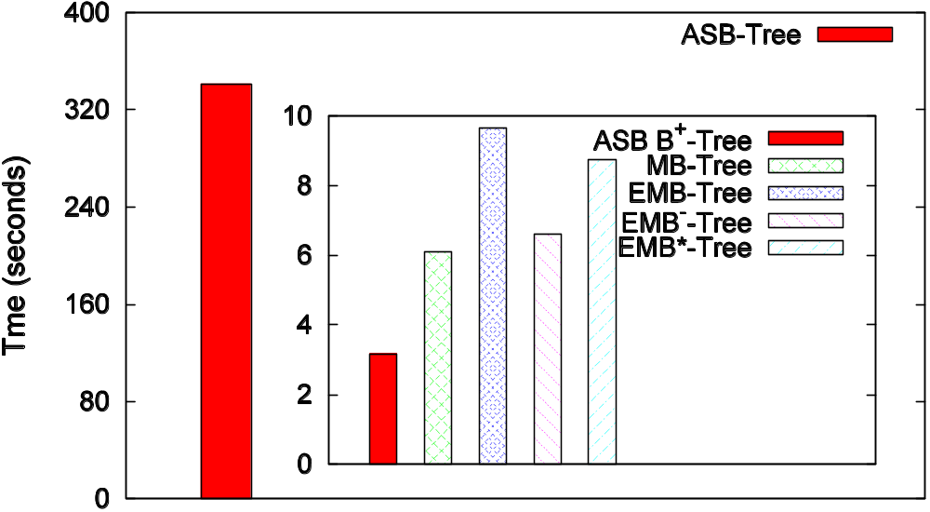
Construction Cost: time
Notes:
H. Hacigumus, B. R. Iyer, and S. Mehrotra, ICDE02

Slide 36
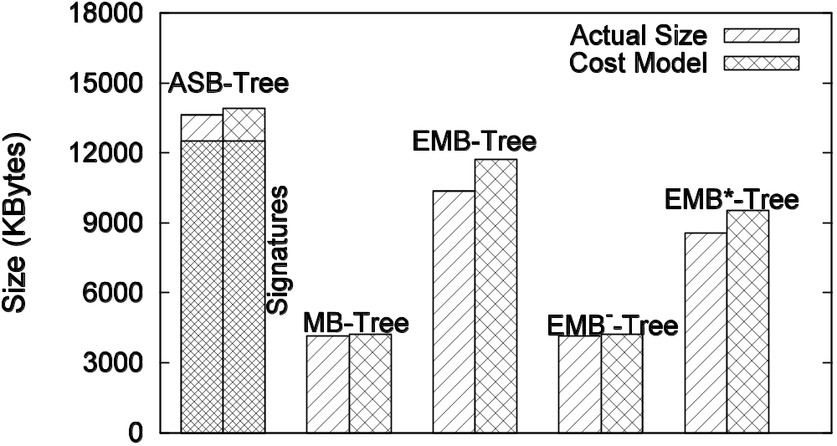
Construction Cost: Size
Notes:
H. Hacigumus, B. R. Iyer, and S. Mehrotra, ICDE02

Slide 37
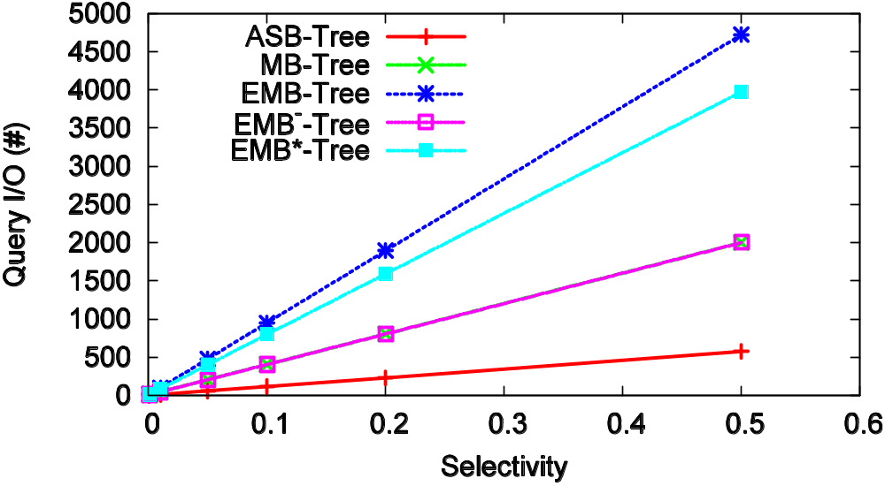
Query specific I/O:
Notes:
H. Hacigumus, B. R. Iyer, and S. Mehrotra, ICDE02

Slide 38
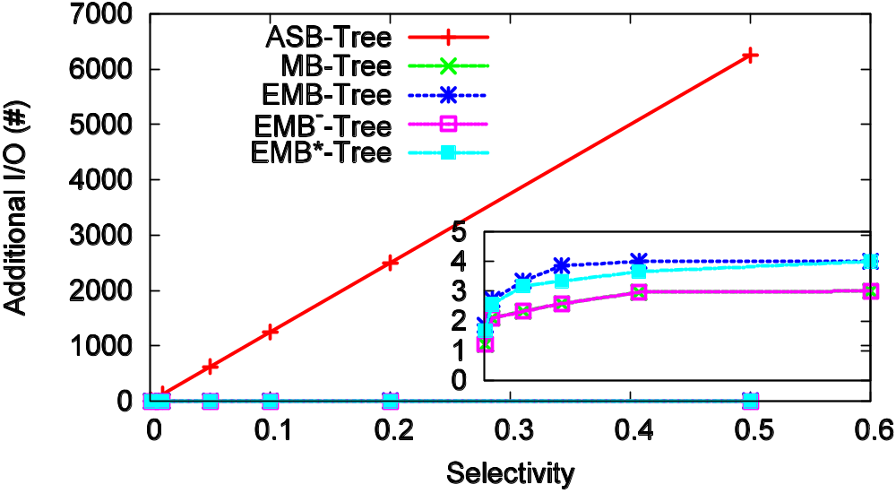
VO construction I/O:
Notes:
H. Hacigumus, B. R. Iyer, and S. Mehrotra, ICDE02

Slide 39
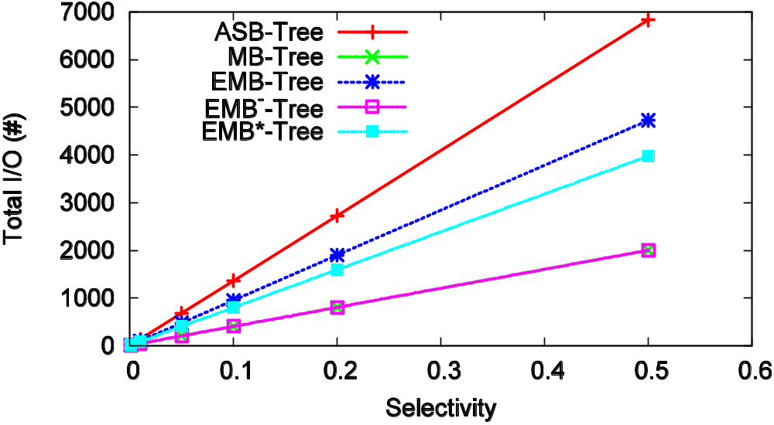
Query Cost: Total I/O
Notes:
H. Hacigumus, B. R. Iyer, and S. Mehrotra, ICDE02

Slide 40
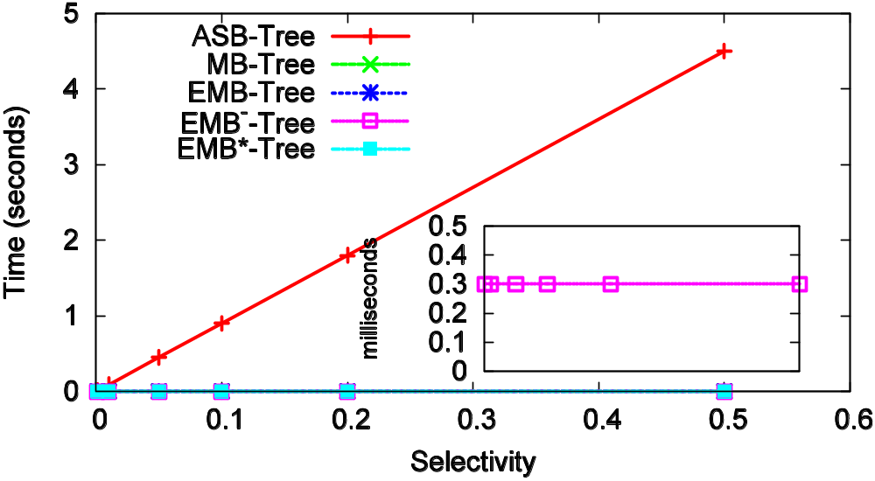
Query Cost: VO computation time
Notes:
H. Hacigumus, B. R. Iyer, and S. Mehrotra, ICDE02

Slide 41
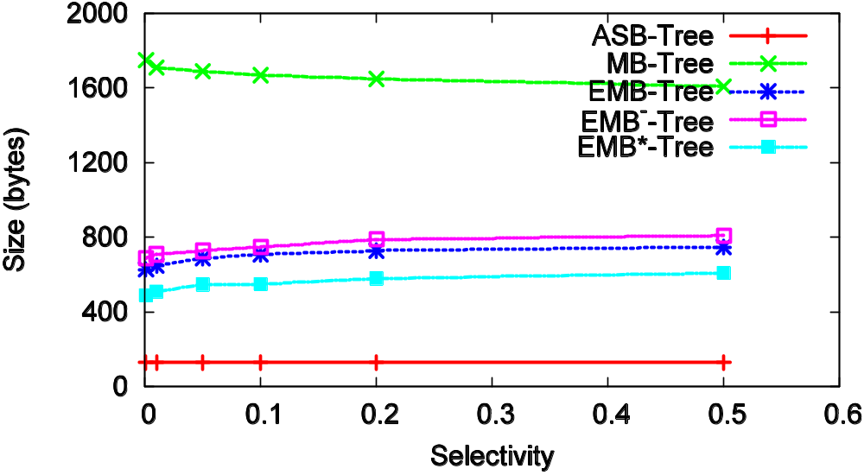
VO size
Notes:
H. Hacigumus, B. R. Iyer, and S. Mehrotra, ICDE02

Slide 42
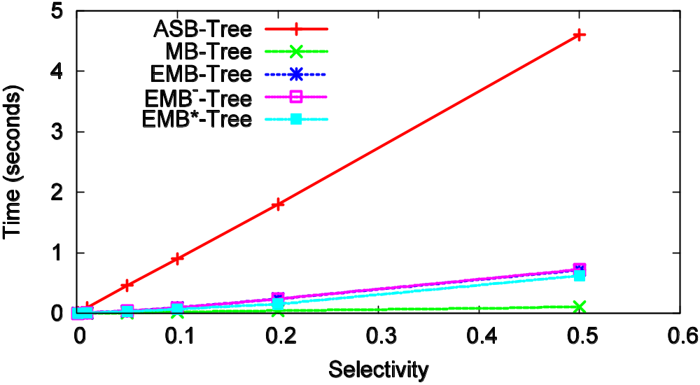
Verification time
Notes:
H. Hacigumus, B. R. Iyer, and S. Mehrotra, ICDE02

Slide 43
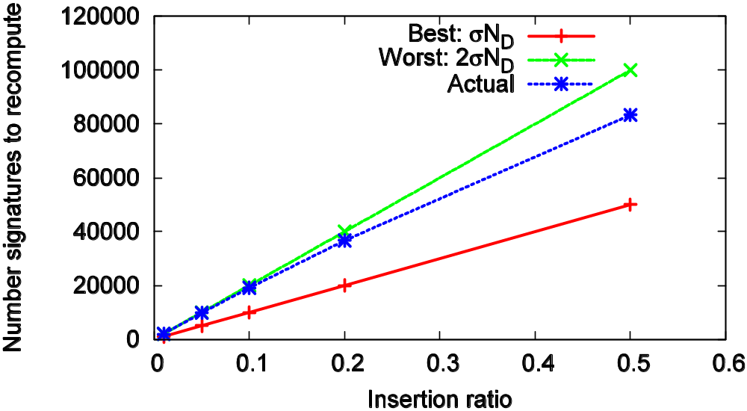
Update for ASB Tree

Slide 44
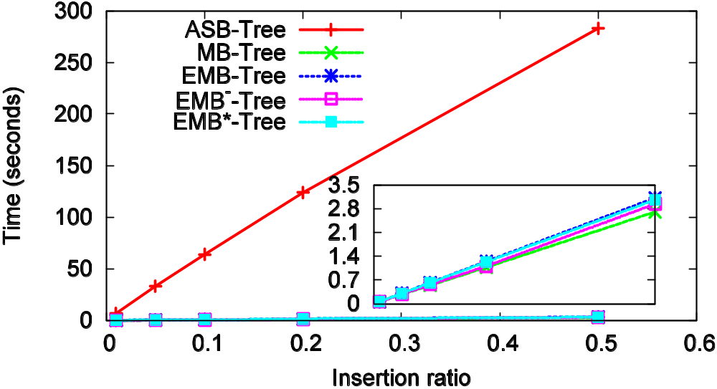
Update cost
Notes:
H. Hacigumus, B. R. Iyer, and S. Mehrotra, ICDE02

Slide 45
Conclusion
Authenticated index structures that achieve good balance between query efficiency and authentication efficiency
Other query types
Multi-dimensional query authentication
Notes:
H. Hacigumus, B. R. Iyer, and S. Mehrotra, ICDE02

Slide 46
Thanks!
Download the Authenticated Index Structure
Library prototype at:
http://cs-people.bu.edu/lifeifei/aisl/
Notes:
H. Hacigumus, B. R. Iyer, and S. Mehrotra, ICDE02

Slide 47
References
[CRYPTO] Crypto++ Library. http://www.eskimo.com/ weidai/cryptlib.html.
[DGMS00] P. Devanbu, M. Gertz, C. Martel, and S. G. Stubblebine. Authentic third-party data publication. In IFIP Workshop on Database Security, 2000.
[DGMS03] P. Devanbu, M. Gertz, C. Martel, and S. Stubblebine. Authentic data publication over the internet. Journal of Computer Security, 11(3), 2003.
[GR97] R. Gennaro, P. Rohatgi. How to Sign Digital Streams. In Crypto 97
[GMR88] S. Goldwasser, S. Micali, and R. L. Rivest. A digital signature scheme secure against adaptive chosen-message attacks. SIAM Journal on Computing, 17(2), April 1988.
[HIM02] H. Hacigumus, B. R. Iyer, and S. Mehrotra. Providing database as a service. In ICDE, 2002.
[M90] K. McCurley. The discrete logarithm problem. In Cryptology and Computational Number Theory, Proc. Symposium in Applied Mathematics 42. American Mathematical Society, 1990.
[M89] R. C. Merkle. A certied digital signature. In CRYPTO, 1989.
Notes:
H. Hacigumus, B. R. Iyer, and S. Mehrotra, ICDE02

Slide 48
References
[MNDGKS04] C. Martel, G. Nuckolls, P. Devanbu, M. Gertz, A. Kwong, and S. Stubblebine. A general model for authenticated data structures. Algorithmica, 39(1), 2004.
[MNT04] E. Mykletun, M. Narasimha, and G. Tsudik. Authentication and integrity in outsourced databases. In Symposium on Network and Distributed Systems Security (NDSS'04), 2004.
[NT05] M. Narasimha and G. Tsudik. Dsac: Integrity of outsourced databases with signature aggregation and chaining. In CIKM, 2005.
[OPENSSL] OpenSSL. http://www.openssl.org.
[PT04] H. Pang and K.-L. Tan. Authenticating query results in edge computing. In ICDE, 2004.
[PJR05] H. Pang, A. Jain, K. Ramamritham, and K.-L. Tan. Verifying completeness of relational query results in data publishing. In SIGMOD, 2005.
[RSA78] R. L. Rivest, A. Shamir, and L. Adleman. A method for obtaining digital signatures and public-key cryptosystems. Commun. ACM, 21(2), 1978.
[SHA195]National Institute of Standards and Technology. FIPS PUB180-1: Secure Hash Standard. pub-NIST, 1995.
Notes:
H. Hacigumus, B. R. Iyer, and S. Mehrotra, ICDE02

Slide 49
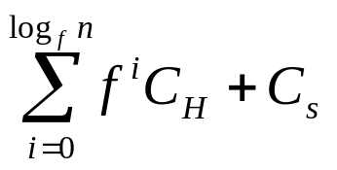
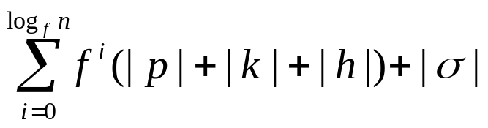
Cost Analysis
 | Merkle B Tree
Construction cost
O/S comm. cost
Storage Cost
Server computation cost | 0
Query cost | O(log_{f}n)
Notes:
H. Hacigumus, B. R. Iyer, and S. Mehrotra, ICDE02

Slide 50
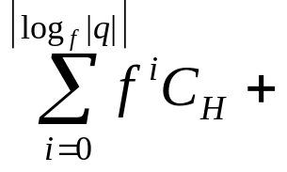

Cost Analysis
 | Merkle B Tree
Update cost | O(log_{f}n) C_{H}+C_{s}
Update comm. cost | O(log_{f}n) |h|+|σ|
C/S comm. cost
Client computation cost
Notes:
H. Hacigumus, B. R. Iyer, and S. Mehrotra, ICDE02

Slide 51
Freshness?
emm, it’s correct! ☺
Client
Owner
query
Server
update
q+VO
Return VO constructed based
on previous version: σ_{v-1}(s)
new signature(s):
σ_{v}
Notes:
H. Hacigumus, B. R. Iyer, and S. Mehrotra, ICDE02

Slide 52
Solution to Freshness
Must have client-owner communication
  Reduce this communication cost is the key issue
  Observation: this cost is correlated with the number of signatures maintained in the authentication structure used by the owner
Notes:
H. Hacigumus, B. R. Iyer, and S. Mehrotra, ICDE02

Slide 53
Other Query Types
Projection
  Basic authenticated unit for the tuple
Join
  Authenticating one relation first, then authenticate a set of selection queries into the other relation
Aggregate
  Based on Aggregation Index
Notes:
H. Hacigumus, B. R. Iyer, and S. Mehrotra, ICDE02

Slide 54
Condensed RSA [MNT04]
KeyGen:
Choose two large primes, p and q, p≠q
Set n=pq
Compute ϕ(n)=(p-1)(q-1)
Choose e s.t. 1<e<ϕ(n) and e is coprime to ϕ(n)
Compute d s.t. de≡1 (mod ϕ(n))
(d, n) is the secret key and (e, n) is the public key
Notes:
H. Hacigumus, B. R. Iyer, and S. Mehrotra, ICDE02

Slide 55
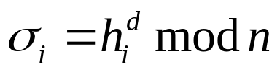
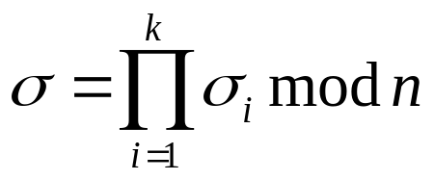
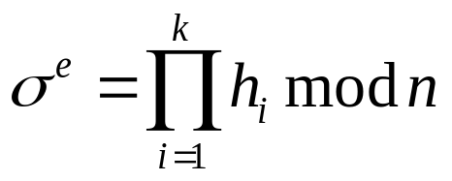
Condensed RSA [MNT04]
Sign:
Given m_{i}, compute h_{i}=H(m_{i})
Compute
Compute
Verify:
Given m_{i}, compute h_{i}=H(m_{i})
Check that:
Notes:
H. Hacigumus, B. R. Iyer, and S. Mehrotra, ICDE02

Slide 56
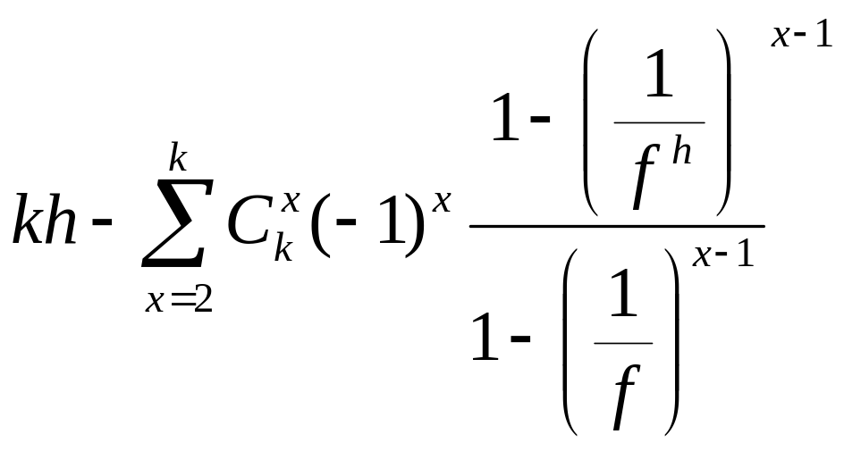
Updates
Batch update will help!
  Using standard bin and ball argument, we can show that number of affected nodes for k updates is:
Cost for Per-update approach
Notes:
H. Hacigumus, B. R. Iyer, and S. Mehrotra, ICDE02

Slide 57
Updates
Batch update still has linear (number of signing
operations) cost.
In terms of number of signing operations:
Insertion - Best case: k+2 Worst case: 2k
Deletion - Best case: 1 Worst case: k
Notes:
H. Hacigumus, B. R. Iyer, and S. Mehrotra, ICDE02

Slide 58
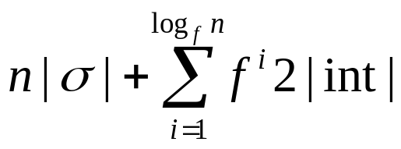
Cost Analysis
 | ASB tree
Construction cost | nC_{s}+C_{b}
O/S comm. cost
Storage Cost
Server computation cost | 0 or |q|C_{mod_mutiplication}
Query cost | log_{f}n+|q|/f+|q||σ|/P
Notes:
H. Hacigumus, B. R. Iyer, and S. Mehrotra, ICDE02

Slide 59
Cost Analysis
 | ASB tree
Update cost | 2C_{s} or C_{s}
Update comm. cost | 2|σ| or |σ|
C/S comm. cost | |q||σ|+|q| or |σ|+|q|
Client computation cost | |q|C_{v} or C_{v}+|q|C_{mod_mutiplication}
Notes:
H. Hacigumus, B. R. Iyer, and S. Mehrotra, ICDE02

Slide 60
Multi-dimensional Range Query [NT05]
Signature chaining
Ordered
-∞
r₆
r₅
r₇
+∞
A₁
-∞
r₂
r₅
r₆
+∞
A₂
-∞
r₇
r₅
r₁₂
+∞
A₃
M. Narasimha and G. Tsudik. CIKM, 2005.
Notes:
H. Hacigumus, B. R. Iyer, and S. Mehrotra, ICDE02

Slide 61
Tradeoff: query vs. authentication efficiency
Key observations:
  Query efficiency vs. authentication efficiency
  Impossible to have one solution that optimizes all cost metrics
Notes:
H. Hacigumus, B. R. Iyer, and S. Mehrotra, ICDE02

